Slide 1


NEXT BUILDERS
Building Africa’s Future Through Local Innovation & Global Vision

Slide 2
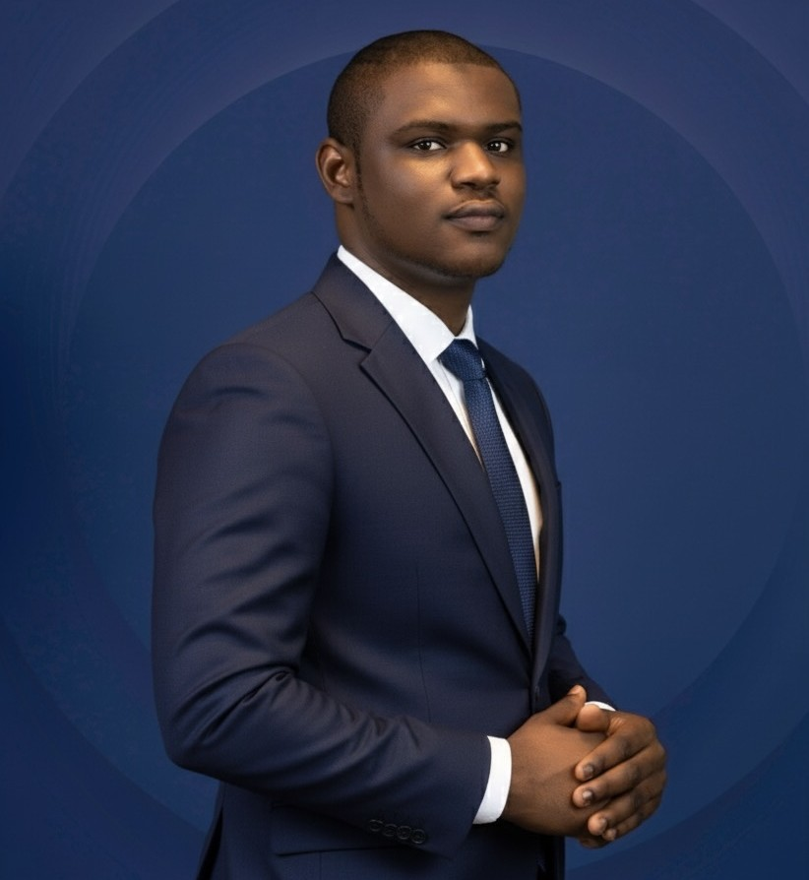
About Speaker
Abdulquadri Saka-Bolanta is a Cybersecurity Professional with Progressive experience across Security Operations, Security Engineering, Penetration Testing, and Incident Response. He holds several industry-standard certifications, such as OSCP, PNPT, PMRP, and BTL1. He’s a founder at Bass Hub Limited and tweets @sakabolanta.

Slide 3
GUIDE TO OPEN-SOURCE INTELLIGENCE (OSINT)

Slide 4
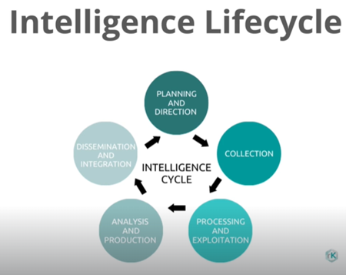
What is OSINT?
Open-Source Intelligence
Open-source intelligence is a multi-method approach for collecting, analysing and making decisions about data accessible in publicly available sources to be used in an intelligence context. In the intelligence community, the term "open" refers to overt, publicly available sources.
Source: TCM Security

Slide 5

Introduction of Sock Puppet
What is a Sock Puppet?
A sock puppet account, or simply a sock puppet, is a false online identity used by a person for deceptive purposes.
In Open-Source Intelligence, "sock puppets" (sometimes called research accounts) are used to access public content that requires an account while protecting the investigator's real identity.
Source: Gemini

Slide 6
How to create a Sock puppet
Requirement
Resources
Fake account, persona
Burner phone/dedicated laptop.
Burner credit card
Mint sim
Be in the location or use a good VPN
The Art Of The Sock
Reddit
Fake Name Generator -
This Person Does not Exist
Privacy.com
Notes:
Privacy.com ties to Autorized user

Slide 7
Your Sock Puppet Mustn’t Tie Back to You
Phone Number
Instant Messaging
Email
Subscribe to VOIP Providers:
    VOIP.ms
Cloaked
Jmp.chat
Twilo
Use | Don’t Use
Signal | Google messaging
Session | SMS
Threema | WhatsApp
Use | Don’t Use
Proton mail | Gmail
Tuta (Tutana) | outlook
 | yahoo
Use Email Aliases:
Kwarabuild.speak3r.com
To use aliases, use https://simplelogin.io/
Notes:
Search Engine
SearXNG is an aggregator. It searches the internent using different search engines and render the results without the trackers or profling.

Slide 8
Social Media OSINT Engine
Search Engines
Resources
Reverse Image Search
Google Advanced Search
DuckDuckGo Search Guide
Google Search Guide
Bing Search Guide
Google Image Search
Yandex
TinEye
Google
Bing
Yandex
DuckDuckGo
Baidu
Notes:
Search Engine
SearXNG is an aggregator. It searches the internent using different search engines and render the results without the trackers or profling.

Slide 9
Exif Tools for Image Metadata
Example Tool
Resources
Physical location OSINT
GeoGuessr
GeoGuessr - The Top Tips, Tricks and Techniques
Jimpl

Slide 10
Email OSINT
Find Email
Verify/Validate Email
Hunter.io
Phonebook.cz
VoilaNorbert
Email Hippo
Email Checker

Slide 11
Username and Password OSINT
Hunting for Username
Hunting for Passwords
NameChk
WhatsMyName
NameCheckup
Dehashed
LeakCheck
SnusBase
HaveIBeenPwned
More Tools

Slide 12
Searching for People
Hunting for Username
Voters Record
WhitePages
TruePeopleSearch
FastPeopleSearch
FastBackgroundCheck
WebMii
PeekYou
411
Spokeo
That’s Them
Voters Records
Voters Ref

Slide 13
Phone OSINT
Hunting Phone Numbers
Social Media OSINT
TrueCaller
Infobel
Twitter Demo

Slide 14
Website OSINT
Tools
More Tools
Domain Dossier - https://centralops.net/co/
DNSlytics - https://dnslytics.com/reverse-ip
SpyOnWeb - https://spyonweb.com/
Virus Total - https://www.virustotal.com/
Visual Ping - https://visualping.io/
Back Link Watch - http://backlinkwatch.com/index.php
View DNS - https://viewdns.info/
urlscan.io - https://urlscan.io/
DNSdumpster - https://dnsdumpster.com/
Web Check - https://web-check.as93.net/
BuiltWith - https://builtwith.com/
Shodan - https://shodan.io
Wayback Machine - https://web.archive.org/

Slide 15
Hunting Business Info
Tools
Open Corporates - https://opencorporates.com/
AI HIT - https://www.aihitdata.com/

Slide 16
THANK
YOU

